Slide 1

Prelude
PRINCIPLES OF PROGRAMMING LANGUAGES

Slide 2
Remarks
Source of video lectures
Assignments have been renumbered
Old Numbering | New Numbering | Comment
A1 | A1 | An assignment focusing on precedence and associativity of SML operators which is auto-graded by the TL System.
A2 | - | This assignment has been eliminated.
A3 | A2 | An assignment focusing on context-free grammars and regular expressions.
A4 | - | This assignment has been eliminated.
A5 | A3 | A group assignment involving the specification of a type-checker for the project language.
A6 | A4 | An SML programming assignment.

Slide 3
Communication
Email: vwinter@unomaha.edu
skype: victor.winter
Canvas Discussions

Slide 4
Student Work
Exclusively electronic submissions!! Disregard any/all references to hardcopy submissions.
homework
project milestones
Quizzes - online
In class (paper and pencil)
Three exams

Slide 5
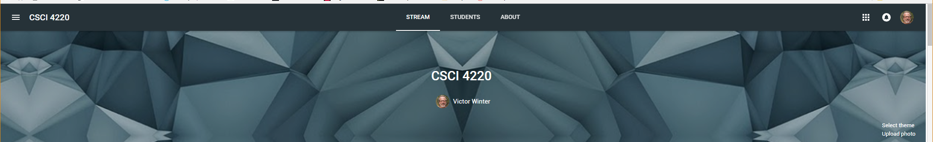
I have made (slightly outdated versions of) most of the video lectures and corresponding slides available in a google classroom which will be accessible throughout the year. To access the content, you need to go to:
classroom.google.com
Then login using your uno email account. One the upper right corner there is the "+" symbol. Click on it and then select "Join class" The code for the class is: nk7anc P.S. Feel free to share this class code will all UNO students.

Slide 6
The next video you should watch is
Introduction 10 – Administrative Details

Slide 7
The End

